Slide 1

Mobile forensics investigation:
Stalker Location
By Michael, Zamarah, Joseph

Slide 2
Table of context
Concept Case
Tools
Analysis
Results
Roles
References

Slide 3
Concept case
This investigation is bases on a scenario where a victim's information has been stolen, which include images, files, web history, and contacts. The stalker has deliberately threatened to leak information to the internet. There has been calls and messages exchange between victim and stalker. The investigation team was able to acquire the stalker phone and extract the android image.
Mobile devices such as tablets and cellphones contain large amount of personal data.
Data includes location, contact info, IP address, mac address, bank account info, personal items

Slide 4

Mobile Forensics: Tools
Objective: Data acquisition,
Magnet Acquire
7-Zip
Autopsy
FTK Imager
Advance tools:
Cellibate
Oxygen Forensics

Slide 5
Process
Identification – Verify the contents and ensure they have not been changed during the investigation. Use MD5 hashing algorithm.
Acquisition - Decompress, extract using 7-zip and use image as a data source for autopsy.
Examination – Examine collect data, artifacts and run keyword searches, this includes call logs, SMS messages, applications, and web history.
Analysis – link patterns and structure a hypothesis base on interpterion of timestamps, call logs, and metadata.
Reporting - create a clear and sound report based on findings and conclusion.

Slide 6
Analysis
Autopsy used to analyze Android 13 forensic image
Extracted SMS, MMS, call logs, and contacts
Recovered images, documents, and deleted files
Examined browser history and downloads
Built timeline connecting communication, file access, and online activity

Slide 7
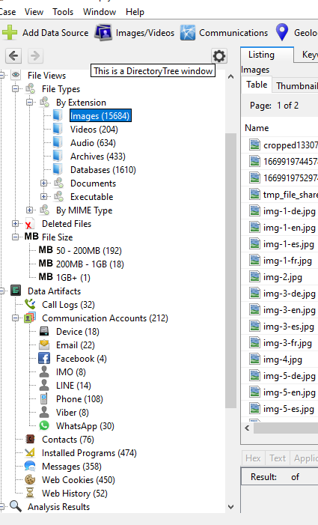
Results
Web history and cookies reveal website user has search however have no connection.
Messages and call logs linked 2 contracts which user call to and from.
User has multiple instant messaging apps, most uses is default messaging app and uses viber for call.

Slide 8
Relevance and Examples
David Heisler – Kidnapping/Murder: His body was found badly decomposed and as electronic device found on crime scene then was used to find the last three of his killers and abductors
Aggravated Arson & Murder: John Williams was killed by his husband in a house fire. His husband later pleaded guilty due to the information found from some electronic devices that were found on the scene
Attempted Murder: Two teenage boys tried to kill a teenage girl because he was ”tired” of her. They were found out by broken devices that were broken by one of the boys
All cases were helped by Utah Tech University’s Digital Forensics Crime Lab
What we are doing is important because everyone is on their phone at least once a day and have everything on it from their bank information to confidential information. It is something we use every day, and the information can be taken every easy if not protected properly.

Slide 9
Questions

